Slide 1
Query by Humming Searching Oct 21st
Jiarui Xu(Jerry), Alexander Lerch

Slide 2
This week
Evaluate query by humming system
Problem in vectorize
Thinking of modification

Slide 3

Evaluate query by humming system
50 wave files with 50 midi ground truth file
Edit distance(just first10 seconds fragment), accuracy:12%
DTW (just, 10 seconds fragment), accuracy:11.5%
Edit distance(40 seconds, hop very note): about 60%(only see the first 10 results)

Slide 4
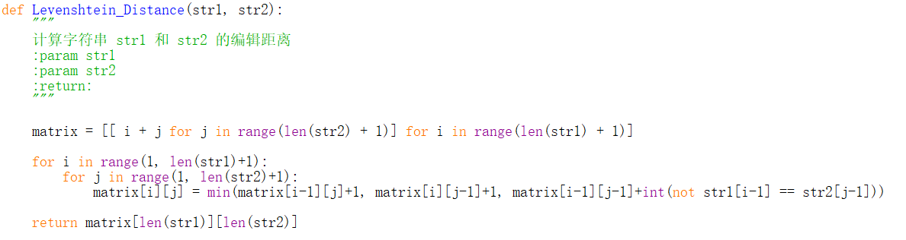
Problem in vectorize

Slide 5
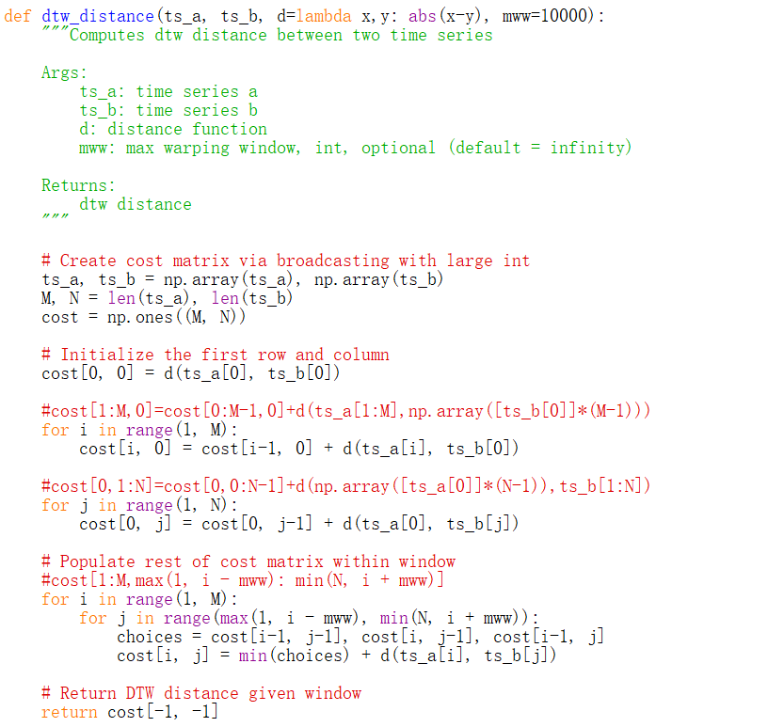
Problem in vectorize

Slide 6
Modifying

Slide 7
Thank you!

